Slide 1
ACCIDENT PREDICTION AND PREVENTING SYSTEM USING DATA-DRIVEN MODELS
THIRD REVIEW
Guided by,
Dr.R.Nallakumar M.E, MBA, Ph.D.,
Associate Professor,
Department of Artificial Intelligence and Data Science,
Karpagam Institute of Technology,
Coimbatore.
Presented by,
S.LINKEDH(721220243028)
M.NATHISH(721220243035)
M.PRASANTH(721220243045)
K. SRIKANTH(721220243053)
Department of Artificial Intelligence and Data Science,
Karpagam Institute of Technology,
Coimbatore.

Slide 2
Outline
Abstract
Module Description and Implementation
Module Diagrams (DFD)
Algorithm Explanations
Project Screen Shots and Demo
Publication Details
International Conference
International Journal
References

Slide 3
ABSTRACT
The "Accident Prediction and Prevention Using Data-Driven Models" project seeks to create a system that combines real-time and historical data to forecast the likelihood of accidents happening and to put preventative measures in place to lower the risk of accidents.
The project entails gathering and analyzing accident data, generating data-driven models, user-friendly and assessing the efficacy of preventive measures.
The project's scope can be implemented in a variety of industries where accidents are a major worry depending on the specific application and data that are available. The improvement of workplace and transportation system safety and accident reduction will result from the system's development.

Slide 4
LIST OF MODULES
Data collection module
(Module 1)
Data preprocessing and feature engineering module (Module 2)
Model development and evaluation module
(Module 3)
Deployment and monitoring module (Module 4)

Slide 5
MODULE 1
DATA COLLECTION
The data collection module is responsible for gathering data from various sources such as
Public databases
Traffic Cameras
Sensors

Slide 6
DATA COLLECTION
In order to obtain raw data and store it in a data pipeline, this module uses data extraction and ingestion techniques.
The data gathered may contain specifics about accidents as well as information about the weather, the state of the road, the volume of traffic, and the type of vehicles involved.
Data scraping involves pulling information out of a website.
It's completely legal to scrape publicly available data.

Slide 7
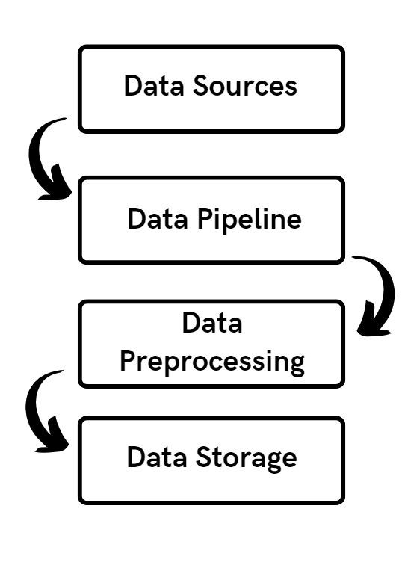
DATA COLLECTION – Data Flow Diagram

Slide 8
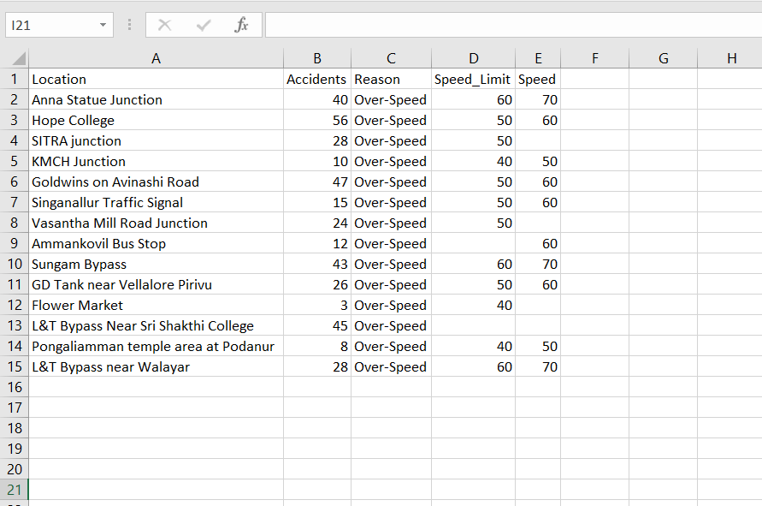
Face Detector – Screen Shots

Slide 9
MODULE 2
DATA PREPROCESSING AND FEATURE ENGINEERING
The data collection module is responsible for gathering data from various sources such as public databases, traffic cameras, and sensors.
In order to obtain raw data and store it in a data pipeline, this module uses data extraction and ingestion techniques.

Slide 10
DATA PREPROCESSING AND FEATURE ENGINEERING
The data gathered may contain specifics about accidents as well as information about the weather, the state of the road, the volume of traffic, and the type of vehicles involved.
Categorical variables need encoding for machine learning. One-hot encoding creates binary columns for each category, while label encoding assigns unique numerical values.
Feature scaling ensures equal importance for features with different scales. Standardization subtracts mean and divides by standard deviation, while normalization scales values to a specific range.

Slide 11
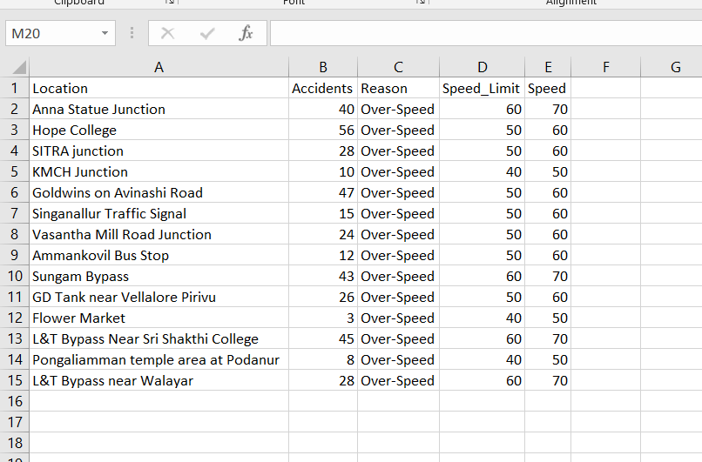
DATA PREPROCESSING AND FEATURE ENGINEERING Results

Slide 12
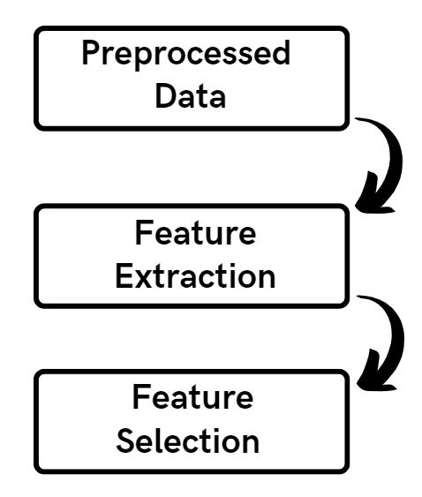
DATA PREPROCESSING AND FEATURE ENGINEERING Data Flow Diagram

Slide 13
Module 3
MODEL DEVELOPMENT
A structured format for machine learning is created from raw data by the data preprocessing and feature engineering module.
To ensure quality and consistency, methods include scaling, normalization, and data cleansing.
For the purpose of predicting accidents, important variables including traffic flow, weather, and time of day are extracted.

Slide 14
MODEL DEVELOPMENT – Algorithm Implemented
Decision Tree:
A decision tree algorithm partitions the data based on features to create a tree-like structure for classification or regression. It splits data based on attributes to maximize information gain or minimize impurity, resulting in a series of decisions that lead to predictions.
K-nearest neighbors (KNN):
KNN is a non-parametric algorithm that classifies data based on the majority vote of its neighbors. It calculates distances between data points and assigns a class label based on the class of its K nearest neighbors. KNN is effective for both classification and regression tasks and requires no training phase.

Slide 15
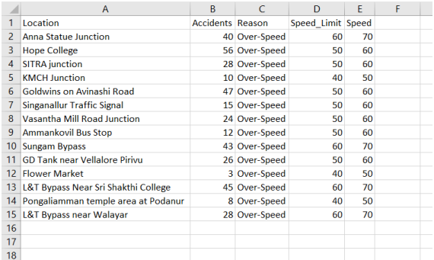
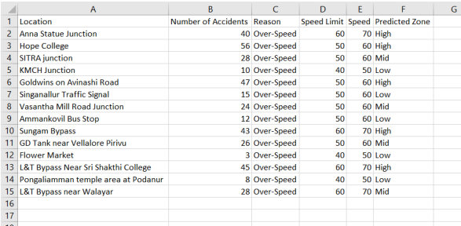
MODEL DEVELOPMENT – Implementation / Results
Input
Output

Slide 16
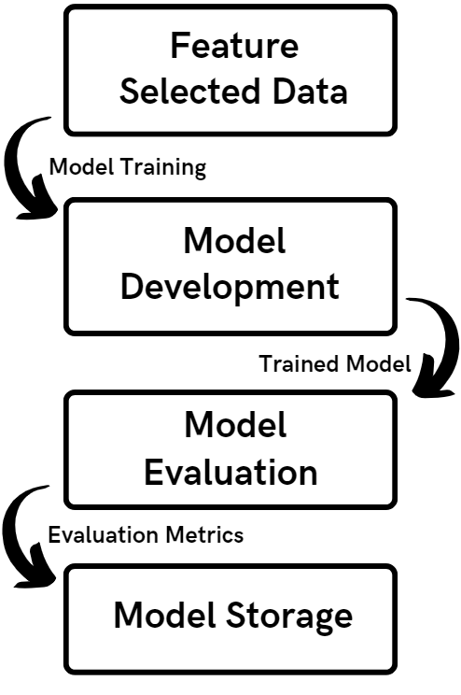
MODEL DEVELOPMENT – Data Flow Diagram

Slide 17
Module 4
DEPLOYMENT AND MONITORING
Deployment module involves implementing preemptive strategies based on the predictions of the machine learning models to prevent accidents before they occur.
Monitoring module continuously evaluates the effectiveness of the deployed preemptive strategies and collects feedback to improve their performance.

Slide 18
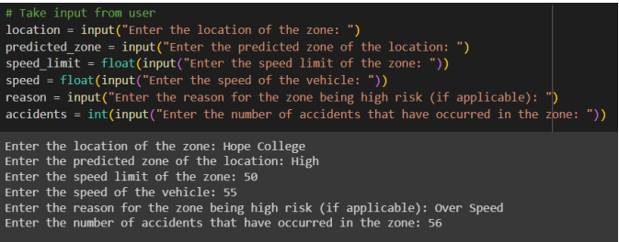
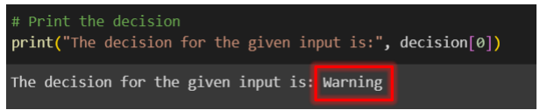
DEPLOYMENT AND MONITORING Results

Slide 19
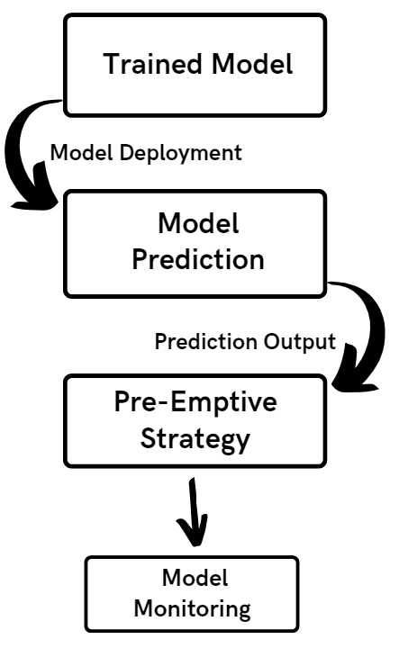
DEPLOYMENT AND MONITORING – Data Flow Diagram

Slide 20
REFERENCES
T. Deva Prakash, Nagaraju V, “Comparative Analysis using K - Nearest Neighbour with Artificial Neural Network to Improve Accuracy for Predicting Road Accidents”, 2022 International Conference on Edge Computing and Applications (ICECAA).
Mohammadreza Hosseinzadeh, Alireza Sadeghi, and Mohammad Mehdi Khosravi , “A Data-Driven Approach to Accident Prediction and Prevention”, IEEE Transactions on Intelligent Transportation Systems, 2022.
Rasika Vijithasena, Wikasitha Herath, “Data Visualization and Machine Learning Approach for Analyzing Severity of Road Accidents”, 2022 International Conference for Advancement in Technology (ICONAT) Goa, India. Jan 21-22, 2022.
Hossein Anisi, “Evaluation of the Cyber Security Risk Models (CSRM) in Cloud Computing”, Journal of Machines and Computing, vol.2, no.3, pp. 124-133, July 2022

Slide 21
Thank You!

